Slide 1
SwiftTinyHTTP
Grace Asaad, Taylor Atkinson, Suraj Srinivasa, Ini Ogunsanya, Tommy Hall, Isaiah Deppong

Slide 2
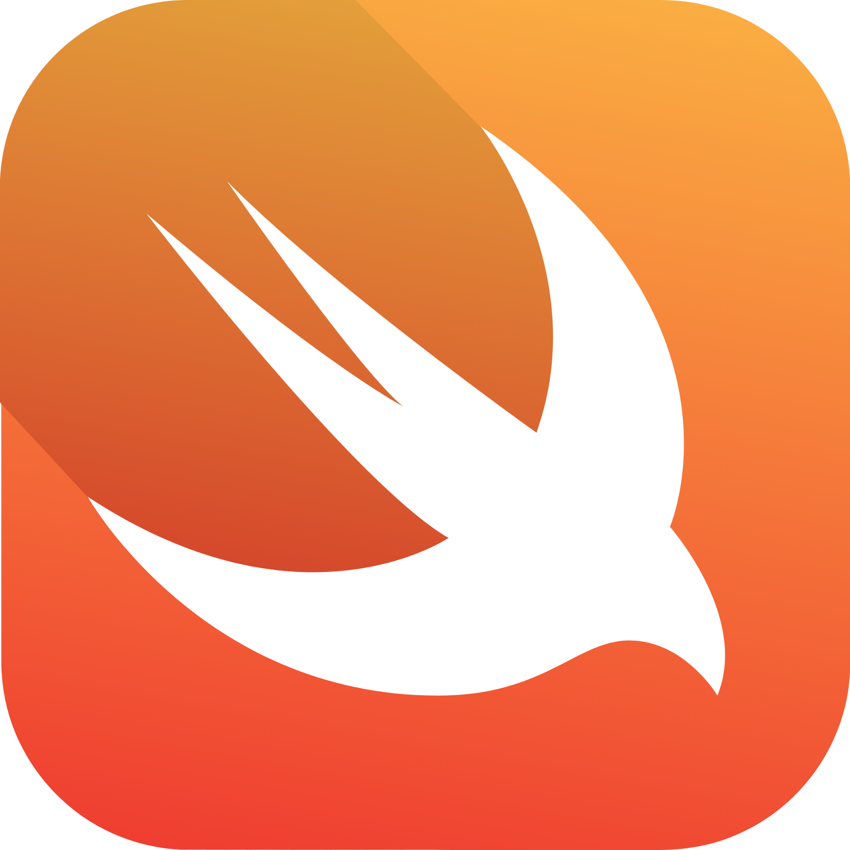
What is the language Paradigm
TJ
Swift is a multi-paradigm programming language. It supports:
Imperative/procedural programming
Object-Oriented programming
Functional programming
Protocol-oriented programming

Slide 3
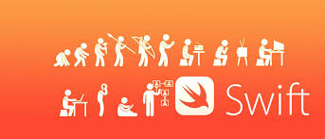
How it fits into historical evolution of programming languages
Grace
Swift was introduced by Apple in 2014 as a modern replacement for Objective-C. There was a need for a more secure programming language. its roots trace back to Apple’s NeXT platform from the early 1990s, which later evolved into today’s iOS and macOS. Swift draws design inspiration from multiple languages, including not just Objective-C but also Python, Haskell, C#, and CLU, combining their best ideas into a unified modern syntax.

Slide 4
What we found different about swift from other languages
Taylor
Swift differs from other multi-paradigm languages because of its emphasis on protocol-oriented programming, prioritizing protocols and value types over traditional class inheritance.
It also offers a rare combination of memory safety, modern syntax, and C-level performance, while still allowing seamless interoperability with low-level C APIs something that many languages in the same paradigm do not provide.
Notes:
Taylor

Slide 5
Features we found helpful
Isaiah
Nil
Familiar syntax
Option types
Built-in package manager
Forced Memory Safety
C++ interoperability

Slide 6
What swift offers to programmers
Ini
Swift offers a combination of high-level readability and low-level performance, making it suitable for a wide range of applications.
The language is designed with strong safety features that reduce bugs and improve reliability.
Swift’s cross-platform capabilities allow developers to build programs that run on macOS, iOS, Linux, and Windows***.
Because Swift can interface directly with system-level APIs, it gives programmers the flexibility to build both application-level and systems-level software.

Slide 7
What type of application swift is best suited for
Suraj
Swift is best suited for building applications within the Apple ecosystem, such as iOS, macOS, etc, because it was designed specifically for these platforms and integrates tightly with Apple’s frameworks. However, Swift is also well suited for server-side development and command-line tools.

Slide 8

Demo of project
TJ

Slide 9
Resources
TJ
ProgKids. “Swift Programming Language: History, Features, Prospects - ProgKids.” Progkids.com, 3 May 2024, www.progkids.com/en/blog/swift.
GeeksforGeeks. “Swift Programming Language.” GeeksforGeeks, 19 Sept. 2023, www.geeksforgeeks.org/swift/swift-programming-language.

